Slide 1
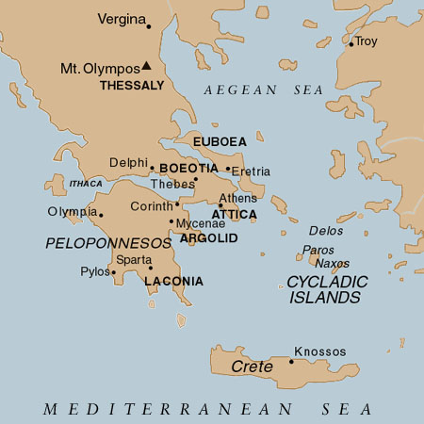
Art of Ancient Greece
Click for video intro to ancient cultures

Slide 2
Terms, Ancient Greece
Humanism
Polis/acropolis
Olympiad
Agora
Stoa
Palaestra
Amphora
Kylix
Krater
Black-figure
Red-figure
Bi-lingual painting
Entasis
volute
Kouros
Kore
Peplos/chiton
Caryatid
Centauromachy
Contrapposto
Chiastic
Propylaia
Pinakotheke
Canon of proportion
foreshortening
Doric/Ionic/corinthian order
*see illustration for parts of a temple, theatre, etc*

Slide 3
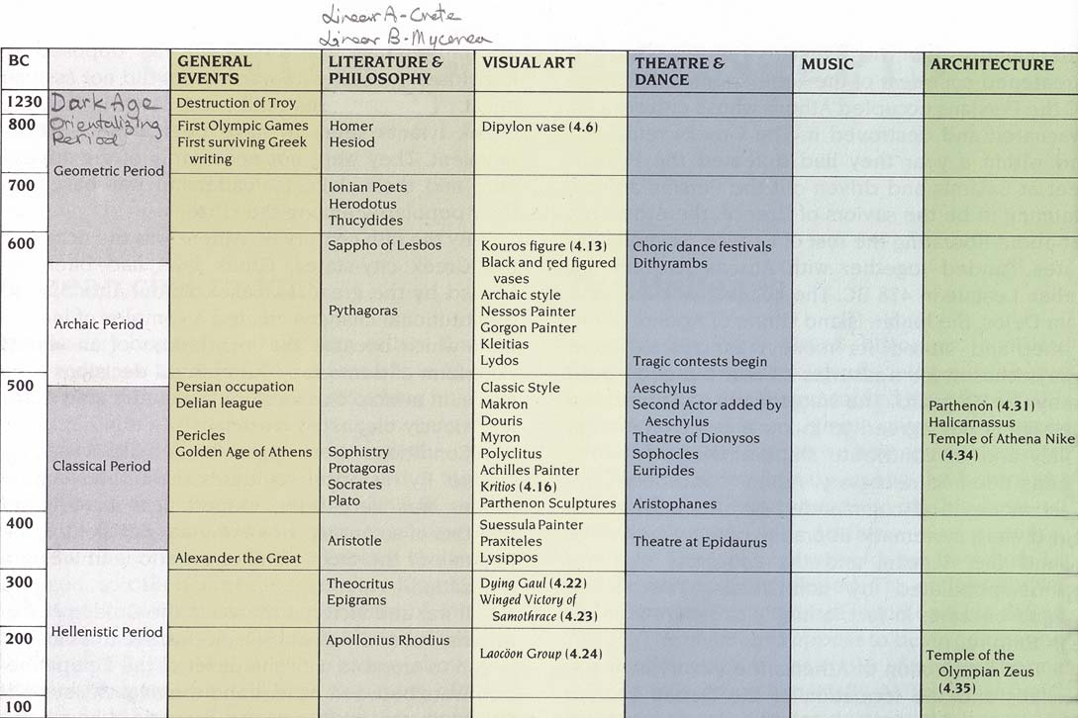

Slide 4
The Greek Alphabet –adaptation of the Phoenician –a Near Eastern Semitic language. English word: Alphabet :combines first two letters of the Greek alphabet –ALPHA & BETA-equivalent to the Semitic Aleph & Beth.
Also adopted the COIN system from the NEAR EAST
Exact origins of the HELLENES ( as the Greeks call themselves) –unknown. C.800 BCE –two related Greek peoples settled in Greece: DORIANS –on the mainland. IONIANS: Easternmost part of the mainland, Aegean Islands & west coast of Anatolia ( modern Turkey)
CENTRALITY of MAN in relation to the NATURAL World: Man & his ability to REASON
Followed the CITY-STATE (POLIS) system of Government. Disliked the Egyptian & Mesopotamian rule of Kings-DEMOCRACY ( DEMOS= People, KRATOS= Power)
Greeks saw themselves as the most civilized people-especially after defeating the Persians in 490 & 480 BCE: any foreigner was called a BARBAROS ( Spoke a foreign language –unintelligible words like “bar-bar”)-from which we get the word BARBARIAN
Religion: Polytheistic: Delphi –site of the Sacred Oracle ( a priestess who was divinely inspired) seen as the NAVEL (center) of the world –center of international influence –because of her ability to foretell futures.
Measured TIME –not according to the Egyptian/Mesopotamian system of Kings & Dynasties –but according to the OLYMPIADS –Four Year Periods. –1st GAMES –776 BCE –PANHELLENIC –only Greek-speaking participants

Slide 5
Greek Artistic Development
Geometric (c. 1000-700 BCE) Orientalizing (c. 700-600 BCE) Archaic (c. 600-480 BCE) Early Classical/Severe or Transitional (c. 480-450 BCE) Classical (c. 450-400 BCE) Late Classical (4th century BCE) Hellenistic (c. 323-31 BCE)

Slide 6
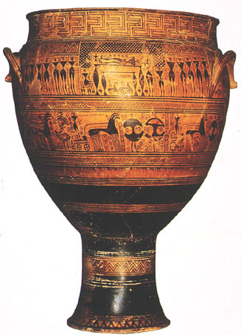
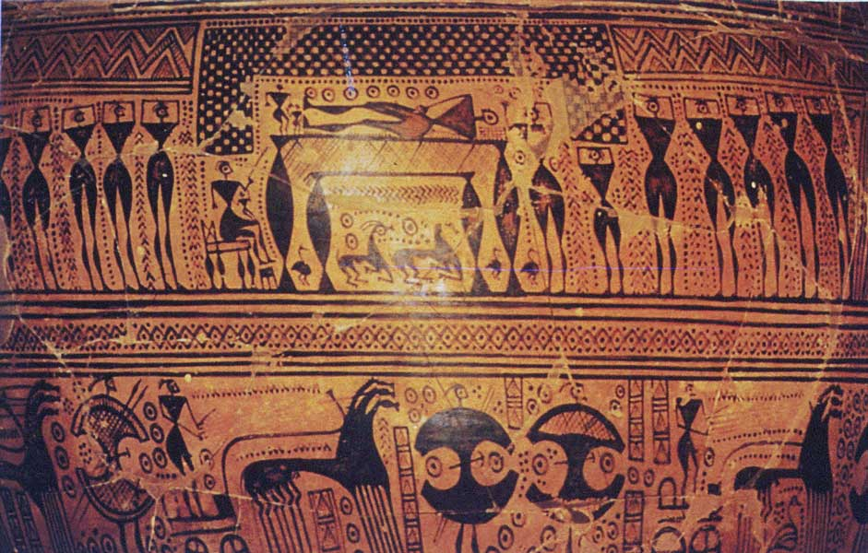
Click for video
Geometric Krater, from the Dipylon cemetery, Athens. Ca. 740 BCE

Slide 7
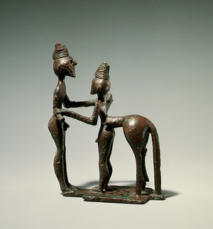
Hero and Centaur (Herakles and Nessos?) ca. 750-730 BCE Bronze
Figures are rare in Geometric style art

Slide 8
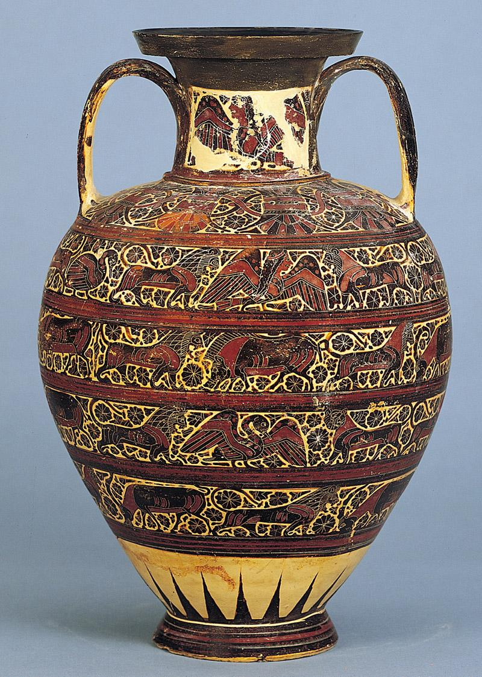
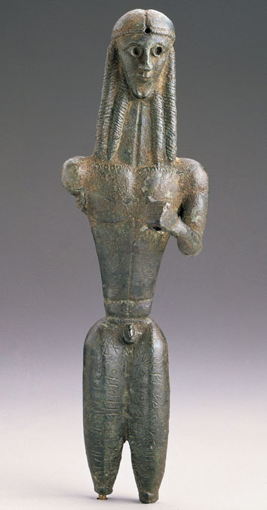
Orientalizing – shows influence of east
Mantiklos Apollo ca. 700-680 BCE
(dedication scratched into surface by someone named Mantiklos)
Corinthian black-figure amphora from Rhodes
Ca. 625-600 BCE

Slide 9
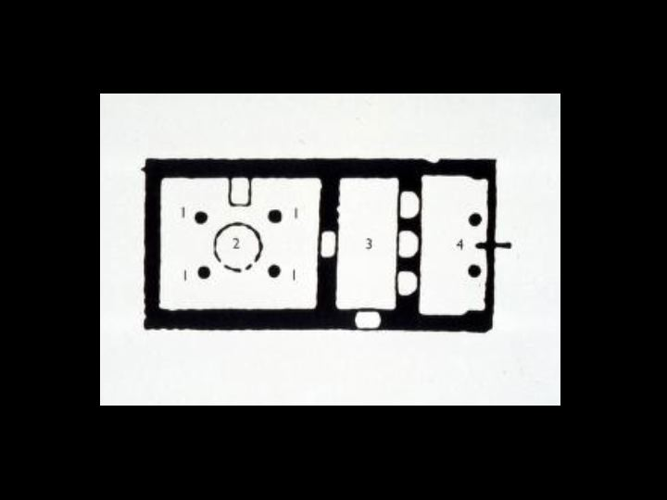
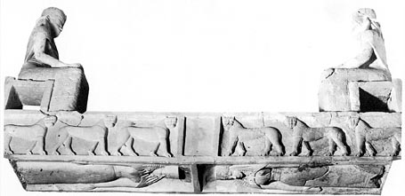
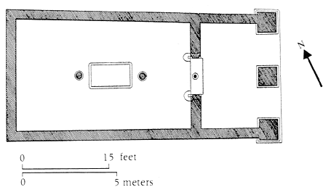
Mycenaean Megaron
Lintel and Plan of Temple A, Prinias Greece ca. 625 BCE
Orientalizing design and early example of Greek Temple

Slide 10
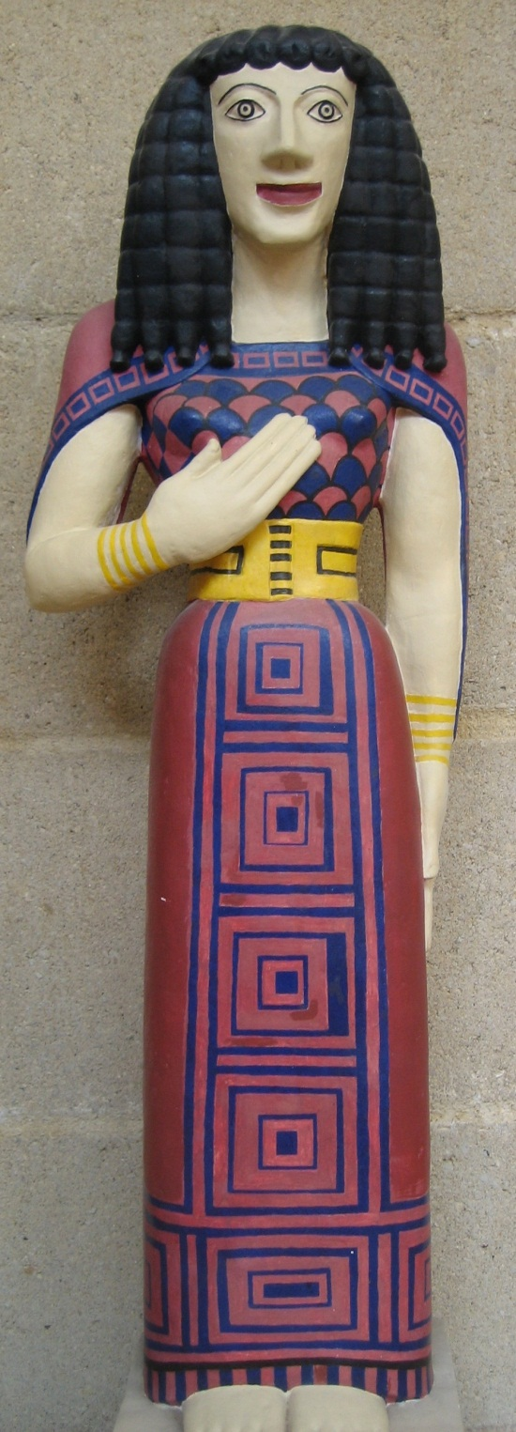
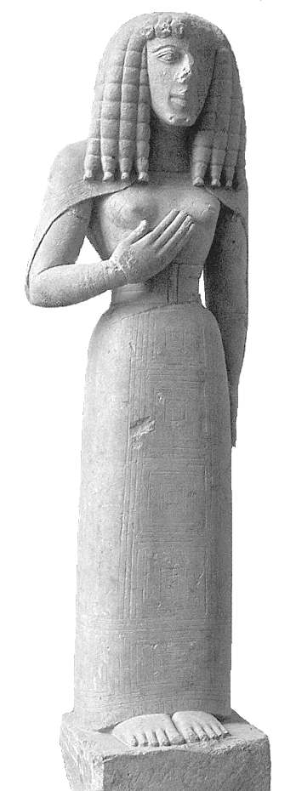
Lady of Auxerre,
ca 650-625 BCE
How did Greek
Sculptors create
The female form?

Slide 11
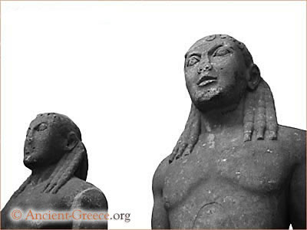
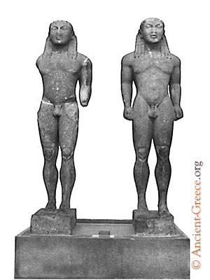
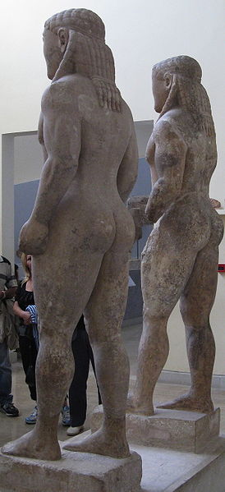
Archaic Period
Kleobis and Biton (or Dioscuri – sons of Zeus?)
Early 6th c. B.C. (circa 580 B.C.) Made by Polymedes
Lifesize

Slide 12
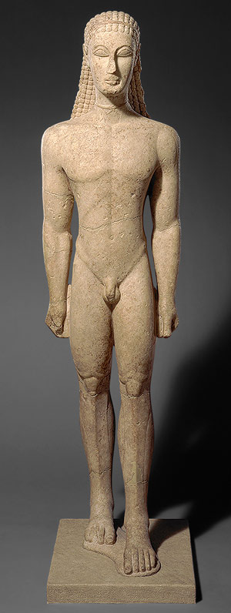
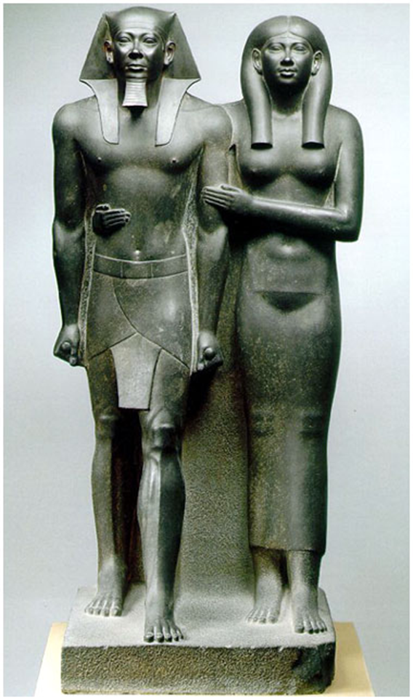
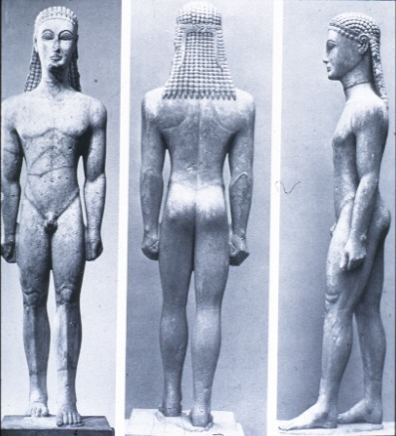
Metropolitan Kouros, ca 600 BCE
Compare Archaic Greek with Egyptian
Click for video

Slide 13
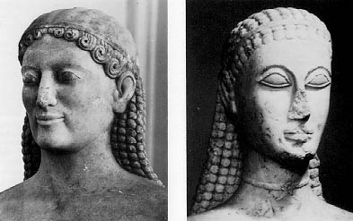
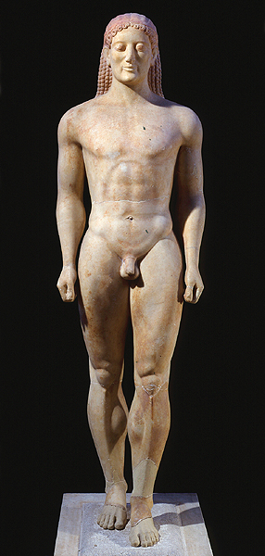
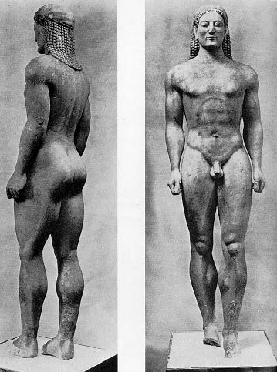
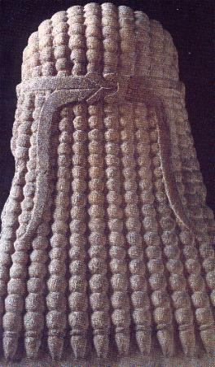
Kroisos, from Anavysos, ca. 530 BCE

Slide 14
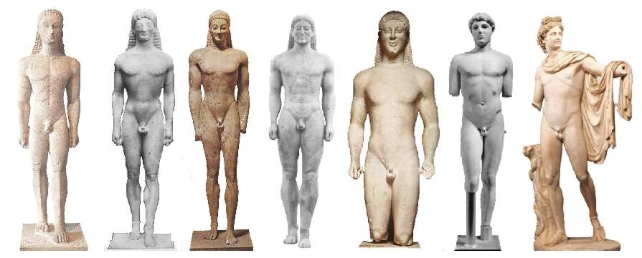
Development of male figure in Greece

Slide 15
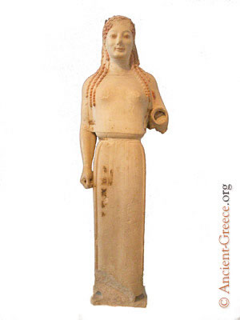
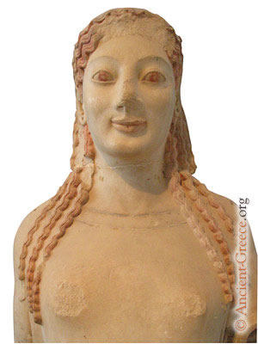
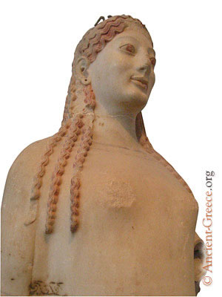
Peplos Kore, from the Acropolis, ca 530 BCE

Slide 16
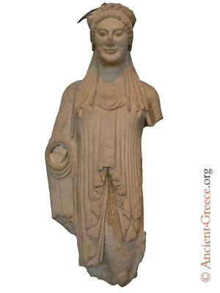
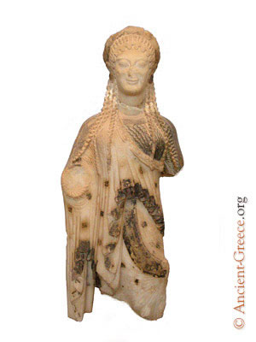
Marble Kore, c. 510 BCE
Kore, with elaborate chiton. Marble, ca. 520-510 BCE.

Slide 17
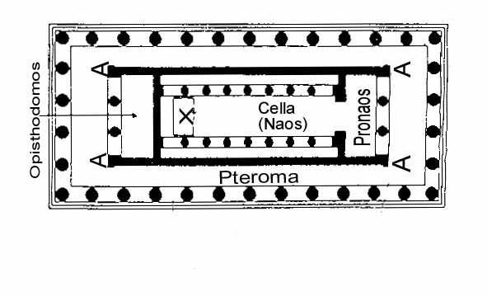
Plan of a typical Greek temple

Slide 18
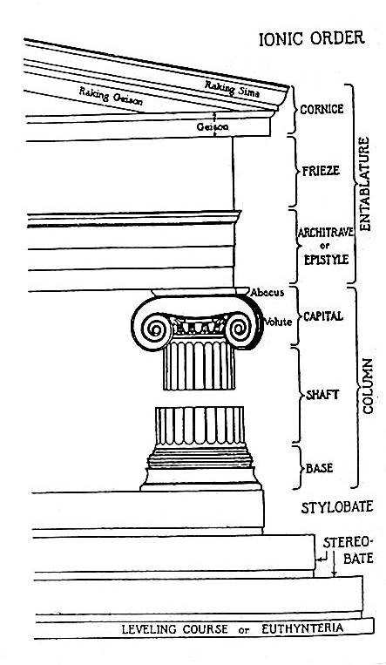
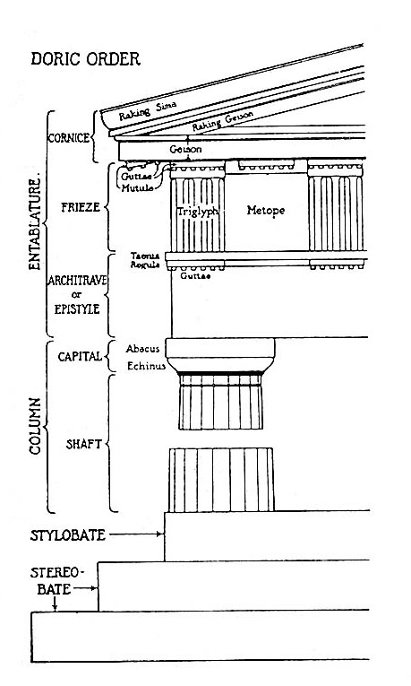
Pediment
Greek Orders of Architecture
Click for video on Classical orders

Slide 19
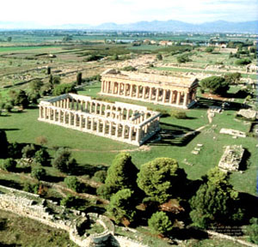
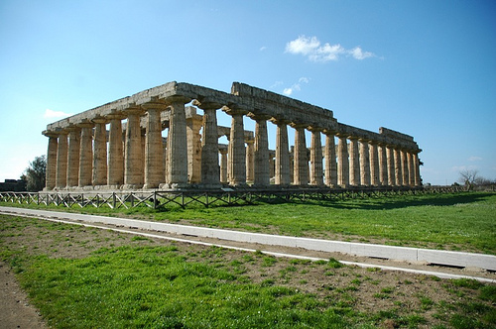
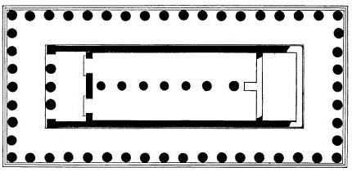
Click for Paestum video
Aerial View of Paestum with Temple of Hera I and
Temple of Hera II (460 BCE) in distance
Temple of Hera I (Basilica), Paestum, Italy.
ca. 550 BCE.
Plan, Temple of Hera I
With central row of columns, an archaic temple feature

Slide 20
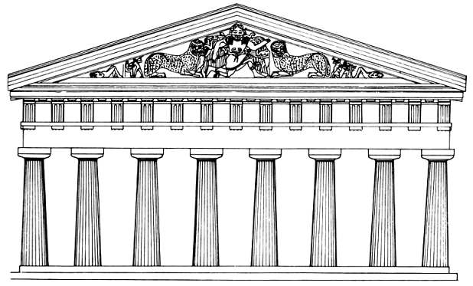
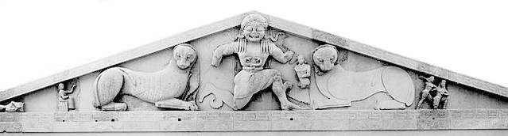
West pediment, Temple of Artemis, Corfu, 600-580 BCE

Slide 21
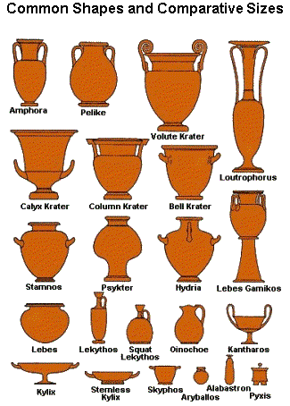

Slide 22
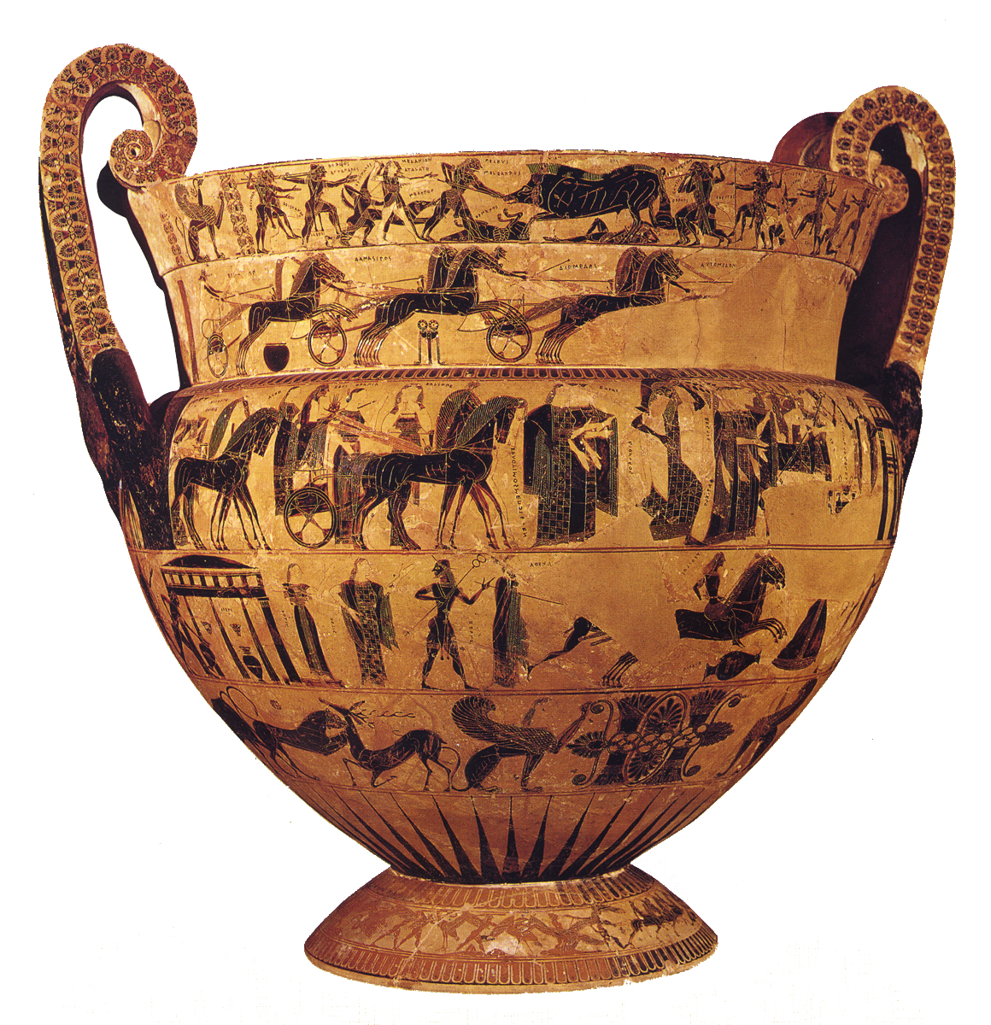
Ergotimos (potter) and Kleitias (painter), The Francois Vase.
Attic Black-figure volute Krater from Chiusi, c.570 BCE

Slide 23
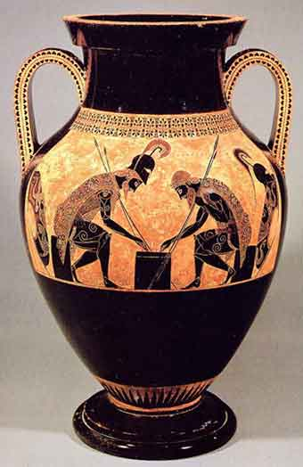
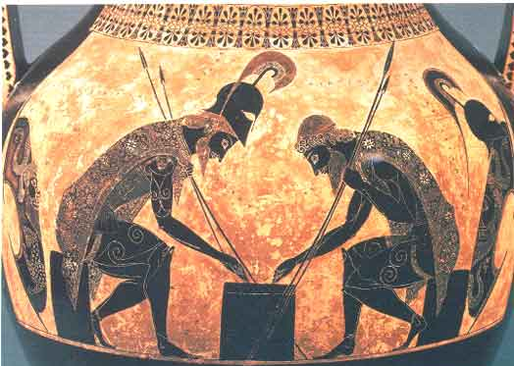
Click for video on this Amphora
Click for black figure technique
Black Figure Painting
Exekias, Achilles and Agax playing Dice, Attic black-figure Amphora from Vulci, Italy. Ca. 540-530 BCE.

Slide 24
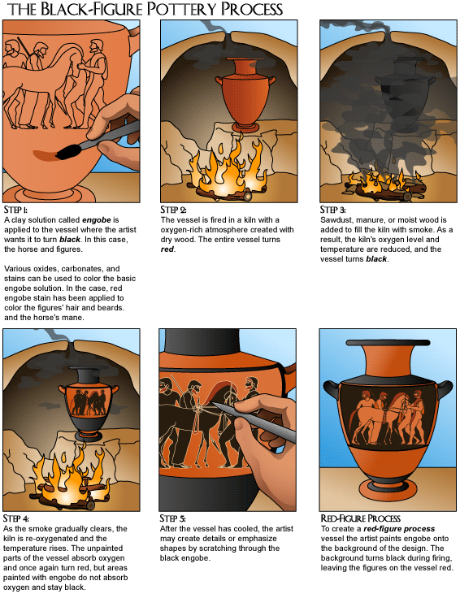

Slide 25
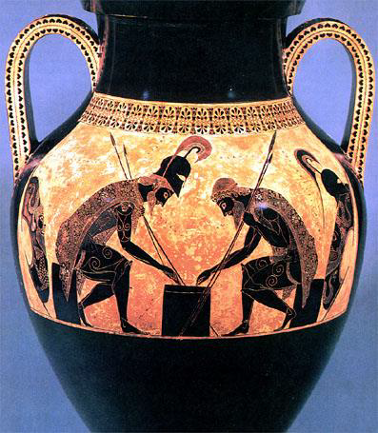
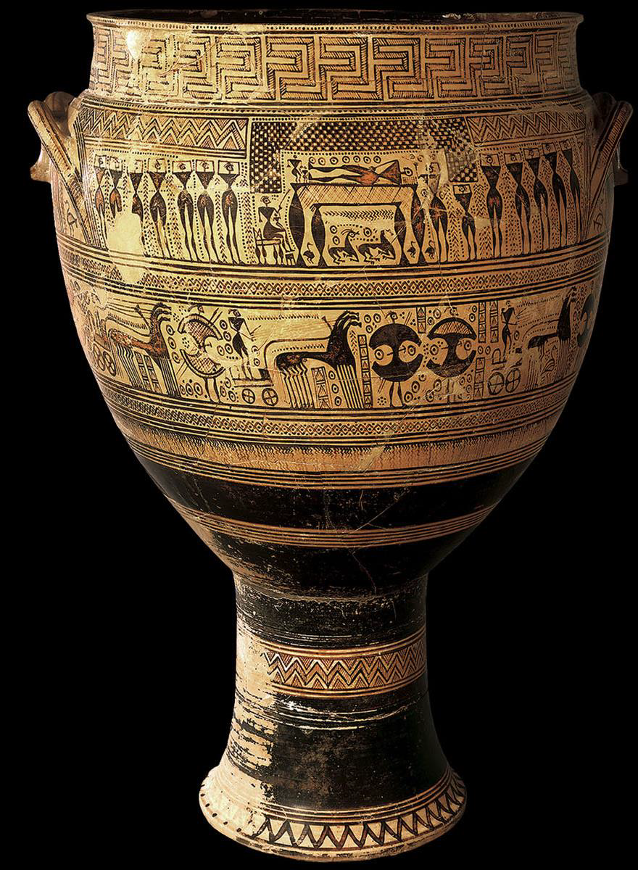
Compare and contrast these two vases –one was a grave marker-also look at the division of the vase surface(picture space), size and representation of the human figures etc….

Slide 26
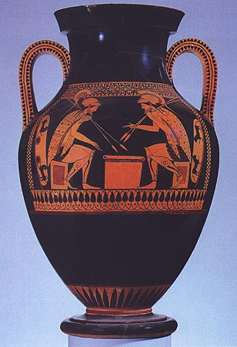
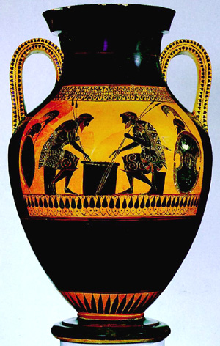
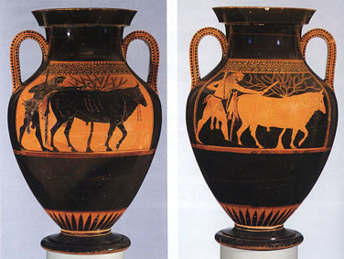
Andokides Painter.
Achilles and Agax playing a dice game (Attic Bilingual Amphora) from Orvieto Italy,
ca. 525-520 BCE
Bilingual Amphora by Andokides Painter

Slide 27
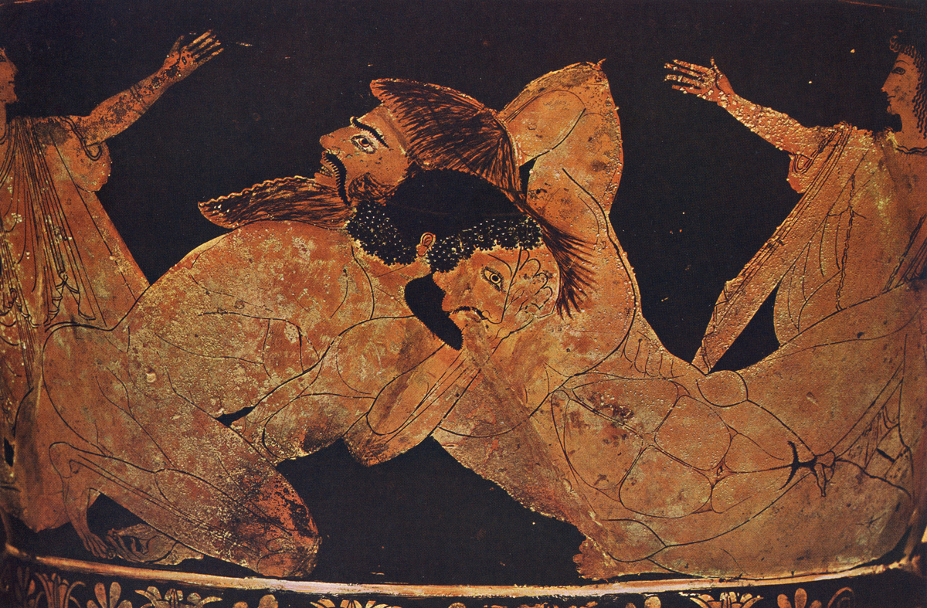
Euphronios. Herakles wrestiling Antaios (detail of an Attic red-figure calyx Krater) from Cerveteri, Italy, ca 510 BCE RED FIGURE VASE PAINTING

Slide 28
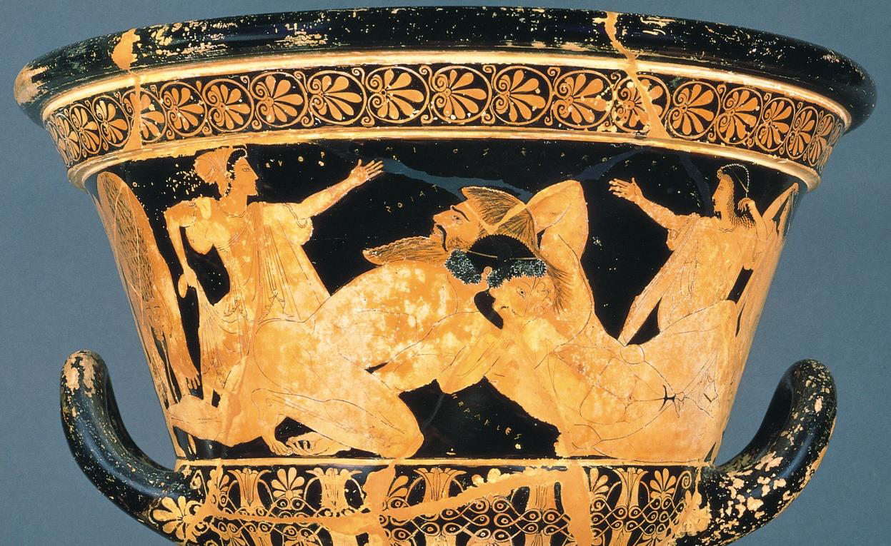
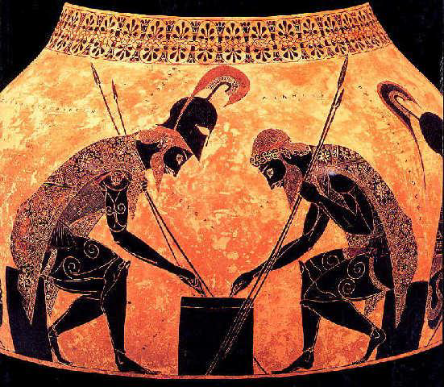
Euphronios, Herakles Wrestling Antaios, Archaic Period, c. 510 BCE, calyx krater
Exekias, Achilles and Ajax Playing a Dice Game, Archaic Period, c. 540-530 BCE, painted terracotta
Compare these
Two vases

Slide 29
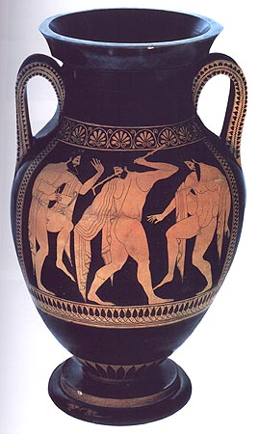

Onesimos, Bathing Girl (interior of an Attic red-figure Kylix) from Chiusi, Italy, ca 490. BCE
Euthymides, Three revelers (Attic red-figure Amphora) from Vulci, Italy, ca 510 BCE

Slide 30

The Berlin Foundry Cup is a red-figure kylix (drinking cup) from the early fifth century BC. It is the name vase of the Attic vase painter known conventionally as the Foundry Painter. Its most striking feature is the exterior depiction of activities in an Athenian bronze workshop or foundry. It is an important source on ancient Greek metal-working technology.

Slide 31

Foundry Painter, A Bronze Foundry c. 490-480 BCE.
Red figure vases show FORESHORTENING of figures. Black
Figure vases show space through overlapping forms. Note squating man’s body is foreshortened to show it in space.

Slide 32




Temple of Aphaia, Aegina. Ca 500-490 BCE
Archaic Greek temple design

Slide 33



Click for video
How did the sculptors
Solve the problem of how to fit figures into the triangular space of the pediment?

Slide 34


Dying Warrior, from the west Pediment, Temple of Aphaia, Aegina, 500-490 BCE
Dying Warrior, from the east Pediment, Temple of Aphaia, Aegina, 490-480 BCE

Slide 35



East pediment
Artist’s rendering
Chryselephantine sculpture of Zeus
(Libon or Elis), Temple of Zeus, Olympia, ca 470-456 BCE

Slide 36


Seer, from East pediment, temple of Zeus, Olympia
Ca 470-456 BCE
Rare image of older person
Athena, Herakles, and Atlas with Apples of Hesperides
Metope from Temple of Zeus, Olympia

Slide 37



Kritios Boy, from the Acropolis, Athens
Ca. 480 BCE

Slide 38


Charioteer of Delphia, ca 470 BCE

Slide 39



Riace Warrior
Ca 460-450 BCE

Slide 40



Zeus or Poseidon, ca 460-450 BCE

Slide 41



Click for video
Polykleitos, Doryphoros
Roman copy after bronze original
Ca 450-440 BCE
Myron, Diskobolos
Roman copy after bronze original of ca 450 BCE

Slide 42

Map of the Acropolis of Athens in Socrates and Plato's time

Slide 43


Slide 44


The east facade of the Parthenon
Iktinos and Kallicrates
Parthenon, Athens
447-438 BCE
Reconstruction of east facade

Slide 45

Click for video – Secrets of the Parthenon
The Parthenon, west facade.

Slide 46




Slide 47




G

Slide 48


Slide 49


Marble copy of the chryselephantine statue of Athena from the Parthenon. Several marble copies and drawings have survived so we can approximate the statue's original appearance. Slight variations appear between each copy.
Artist’s rendering – interior of Parthenon

Slide 50

Detail, Jacques Carrey drawings of Parthenon sculptures

Slide 51



Click for video
Three Goddesses, from East pediment of the Parthenon
438-432 BCE
Helios’s horse and Dionysos or Herakles
East Pediment of the Parthenon

Slide 52

Click for metope video
Originally painted – this Is an artist’s recreation of what they may have looked like
Lapith and Centaur, Metope from the Parthenon, 447-438 BCE

Slide 53

Click for video of frieze

Slide 54

Panathenaic procession, from Parthenon
Ca 447-438 BCE

Slide 55



Mnesikles Propylaia
Acropolis, Athens 437-432 BCE

Slide 56




Click for video
Caryatids-female figures used as support columns
Ionic Columns from the Erechthion
Erectheion, Acropolis, Athens ca 421-405 BCE
Caryatids. At the south porch of the Erechtheion.

Slide 57


Nike Adjusting her Sandal, from Temple of Athena Nike, Acropolis. 410 BCE

Slide 58

Style of Achilles Painter, Woman and Maid, c. 450-440 BCE
White ground lekythos

Slide 59

Phiale Painter, Hermes brining the infant Dionysos to Papposilenos (Attic white-ground calyx krater) from Vulci, Italy, ca 440-435 BCE

